Slide 1

The Time-Varying Nature of Spatial Dependencies in Commercial Real Estate Prices: A Behavioral Explanation
Prashant Das, PhD
Associate Professor of Real Estate Finance
Act. Director: Real Estate, Finance & Economics Institute
EHL Lausanne, Switzerland
In collaboration with:
Parmanand Sinha | University of Chicago
Julia Freybote | Portland State University
Roland Füss | University of St. Gallen, Switzerland
European Real Estate Society
ESSEC, PARIS
4 July 2019

Slide 2
Motivation for the study
Das, P.; Smith, P. & Gallimore,P. (2018). ‘Pricing Extreme Attributes in Commercial Real Estate: The Case of Hotel Transactions’. Journal of Real Estate Finance & Economics, 57 (2), pp 264-296

Slide 3
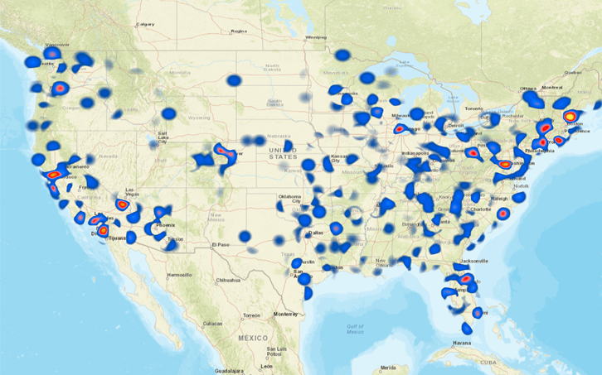

Slide 4
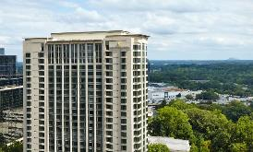
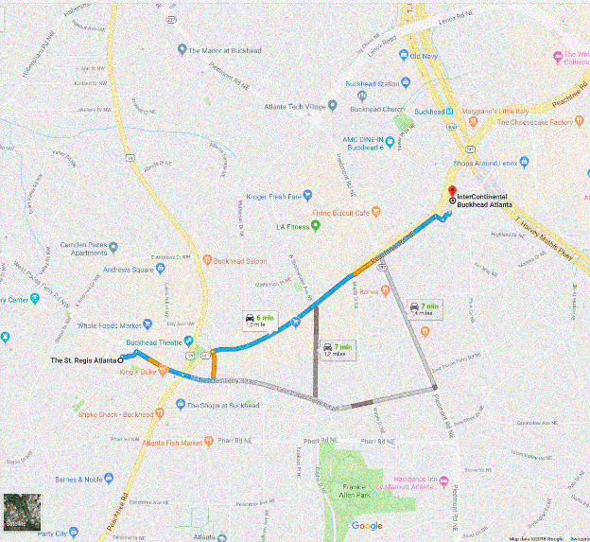

Luxury hotels in Buckhead (Atlanta)
2010Q3: Pebblebrook buys Intercontinental for $105 mi
@ 70% premium
2011Q1: Travistock buys
St. Regis for $160 mi
@ 100% premium

Slide 5

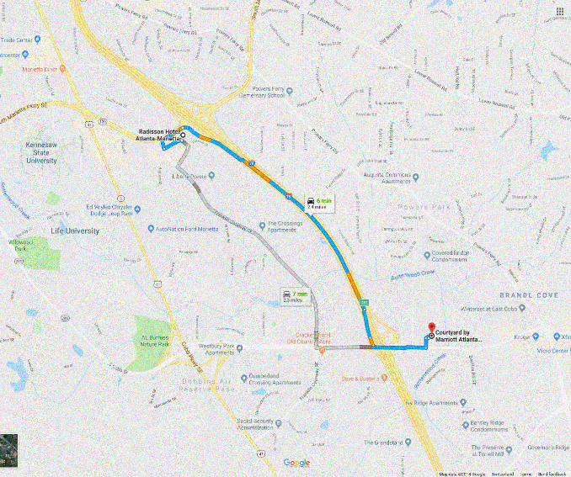

Upscale hotels in Marietta (Atlanta)
2013 Q1: Sage hospitality buys Courtland for $5 mi
@ 30% discount
2013 Q2: The Roberts company sells Radisson for $2.5 mi
@ 45% discount

Slide 6
Research Question
General question:
  What explains the spatial dependence in pricing commercial real estate assets?
Why is this question important?
  Explains the structure of spatial propagation in pricing and mispricing
  Improves prediction in pricing the illiquid commercial assets
Our hypothesis:
  The spatial dependence –at least partially- is driven by investor behavior

Slide 7
Background

Slide 8
Spatial Dependencs
Fixity of Location
  Corgel et al. (2015)
Segmentation & informational inefficiencies
  Ling, Naranjo & Scheick (2014)
  Clauretie and Daneshvary (2009)
  Basu and Thibodeau (1998)
  Dubin (1998)
Spatial regression models
  Admired for their superior explanatory power
  Osland (2010)
  Sinha, Caulkins, & Cropper (2018)
  Criticised for lack of explanation
  Subjectivity in identifying the “economically important spatial effects” (Osland, 2010)
  Difficult interpretation of “spatial reaction” or “resource flow” across neighbopring social agents (Anselin, 2002)
  “Purely mechanical”(Corrado & Fingleton, 2012)
  “Spatial spillover” or “ommitted spatially dependent variables” (Corrado & Fingleton, 2012)
  “Pointless” about “causal economic processes at work” and should best be applied in describing the data (Gibbons & Overman, 2012)
Notes:
Clauretie, T. M., & Daneshvary, N. (2009). Estimating the house foreclosure discount corrected for spatial price interdependence and endogeneity of marketing time. Real Estate Economics, 37(1), 43-67.
Basu, S., & Thibodeau, T. G. (1998). Analysis of spatial autocorrelation in house prices. The Journal of Real Estate Finance and Economics, 17(1), 61-85.
Dubin, R. A. (1998). Spatial autocorrelation: a primer. Journal of housing economics, 7(4), 304-327.
Osland, L. (2010). An application of spatial econometrics in relation to hedonic house price modeling. Journal of Real Estate Research, 32(3), 289-320.
Sinha, P., Caulkins, M. L., & Cropper, M. L. (2018). Do Discrete Choice Approaches to Valuing Urban Amenities Yield Different Results Than Hedonic Models? (No. w24290). National Bureau of Economic Research.
Anselin, L. (2002). Under the hood: Issues in the specification and interpretation of spatial regression models. Agricultural economics, 27(3), 247-267.
Corrado, L., & Fingleton, B. (2012). Where is the economics in spatial econometrics?. Journal of Regional Science, 52(2), 210-239.
Gibbons, S., & Overman, H. G. (2012). Mostly pointless spatial econometrics?. Journal of Regional Science, 52(2), 172-191.

Slide 9
The Rational Spatial Dependence
Omitted Variable bias: micro location characteristics
  Das, Blal & Freybote (2018)
  Chegut et al. (2015)
  Corgel (2007)
Externality-based motivation
  Das, Smith, & Gallimore (2017)
  Corrado & Fingleton (2012)
  Rushmore, S.& O’Neill (2012)
  Lesage & Pace (2009)
  Thrall (2002)
Notes:
“omitted variable motivation” wherein the traditional location controls are found insufficient in capturing the local effects at micro levels
properties compete with each other in their respective local boundaries rather than in rigid census boundaries
Chegut et al. (2015) explains spatial dependence in terms of similar building technology, codes
Corgel (2007) includes Zip-code level per capita income in the empirical analysis and finds a positive impact on prices.

Slide 10
Investor Behavior
Overreaction to the nearby transaction (Fischer, Füss & Stehl, 2018)
“Time-dependence… influenced by the behavior of other agents in the previous period” (LeSage & Pace, 2009)
During Crisis Periods…
Stronger Behavioral Biases in commercial real estate prices (Bokhari and Geltner, 2011)
Spatial correlation:
  Higher in Financial markets (Bradley & Taqqu, 2004)
  Higher in Listed property returns across countries (Zhu and Milcheva, 2016)
  Lower in resuidential real estate (Hyun and Milcheva, 2018)
Notes:
LeSage & Pace (2009) discuss “a time-dependence model” wherein valuation judgments in the current period “are influenced by the behavior of other agents in the previous period,” but do not necessarily posit it as a behavioral bias.
Bradley, B., & Taqqu, M. (2004). Framework for analyzing spatial contagion between financial markets. Finance Letters, 2(6), 8–15.
Zhu, B., & Milcheva, S. (2016). Spatial linkages in (cross-country) listed property returns in tranquil and distressed periods. Journal of Real Estate Portfolio Management, 22(2), 129-146.
Bokhari, S., & Geltner, D. (2011). Loss aversion and anchoring in commercial real estate pricing: Empirical evidence and price index implications. Real Estate Economics, 39(4), 635-670.
Hyun, D., & Milcheva, S. (2018). Spatial dependence in apartment transaction prices during boom and bust. Regional Science and Urban Economics, 68, 36-45.
«spatial dependence in house prices is more pronounced in a rising housing market than in a falling market and can be associated with behavioural biases such as sellers' loss aversion tendency or herding of buyers.

Slide 11
Sentiments
“A belief about future cash flows and investment risks that is not justified by the facts at hand”
  Baker & Wurgler (2007)
Sentiment-Measure in General Finance:
  Closed-end fund discount (Lee, Shleifer, & Thaler, 1991)
  Share turnover (Baker & Wurgler, 2006)
  Spread between the volatility index (VIX) and the actual volatility (Ben-Rephael, Kandel, & Wohl, 2012)
  trading volume (Baker & Wurgler, 2006)
Sentiments-based asset pricing in commercial real estate:
  Clayton, Ling, & Naranjo (2009)
  Das, Freybote, & Marcato (2014)
  Freybote & Seagraves (2017)
  Ling, Naranjo, & Scheick (2013)

Slide 12
Gaps in the Literature
Limited focus on the economics behind spatial dependencies in real estate
Spatial studies focus on residential assets
Some recent studies explain spatial effects in behavioral terms, but:
  Focus on macro-economic phenomena
  Housing trends
  Market fundamentals only
Our approach:
  Focus on spatial dependencies in commercial real estate assets
  Examine sentiments in particular
  Market fundamentals in general

Slide 13
Theory & Hypotheses
Transaction Happens at ‘Expected’ Valuation
Hotel transactions in the US between 2001 & 2016: The two capitalization rates were the same only in 9% cases. In 60% cases, the difference between actual and pro-forma cap rate was substantial and exceeded 100bps.

Slide 14
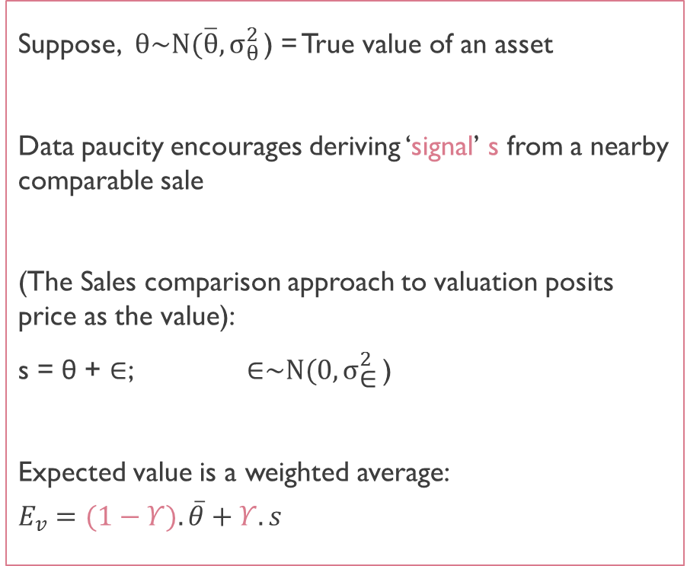
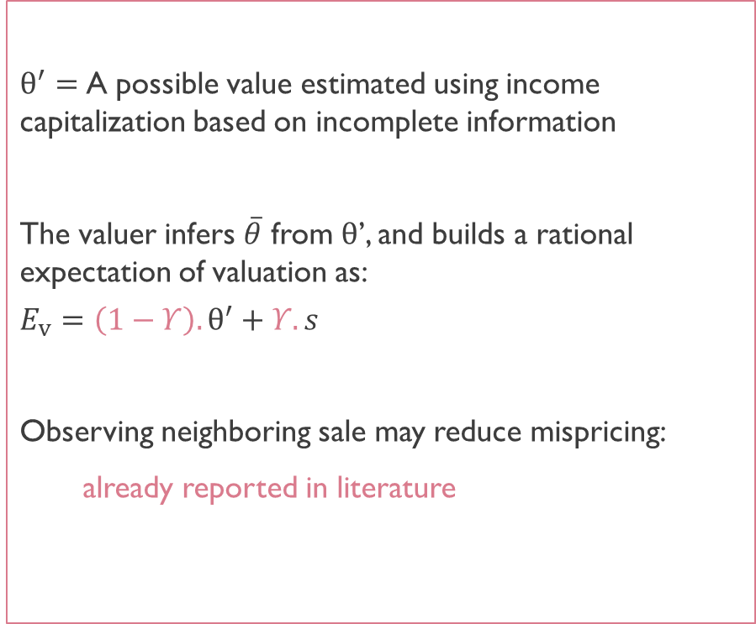
Based on Chang, Luo and Ren (2013); Bokhari and Geltner (2011); Shiller (2003); Northcraft and Neale (1987)
Suppose, $θ\sim N(\overline{θ}{,σ}_{θ}^{2}\text{)}$ = True value of an asset
Data paucity encourages deriving ‘signal’ s from a nearby comparable sale
(The Sales comparison approach to valuation posits price as the value):
s = θ + ∈; $\text{∈}\sim N(0{,σ}_{\text{∈}}^{2}\text{)}$
Expected value is a weighted average:
$$E_{v}=(1−Υ).\overline{θ}+Υ.s$$
$θ^{′}=$A possible value estimated using income capitalization based on incomplete information
The valuer infers $\overline{θ}$ from $θ$’, and builds a rational expectation of valuation as:
$$E_{v}=\left(1−Υ\right).θ^{′}+Υ.s$$
Observing neighboring sale may reduce mispricing:
already reported in literature
Notes:
Equation(A) postulates that the expected asset price for a particular property is the weighted average of the estimated value of the property ($θ′$) and the signal extracted from comparable transactions (s). In real estate the comparable transactions must be in the proximity. Thus, incorporating s in the pricing decision leads to spatial dependence.
s may be a combination of fundamental information, or driven by the participants irrationally excessive tendency to “anchor” the valuation judgment to nearby transactions. Note that the weights fall in a range of [0,1] implying that the expected price lies between and s.
“resource flow” across assets, or simply due to capturing the locally “omitted variables” as explained in LeSage & Pace (2009)

Slide 15
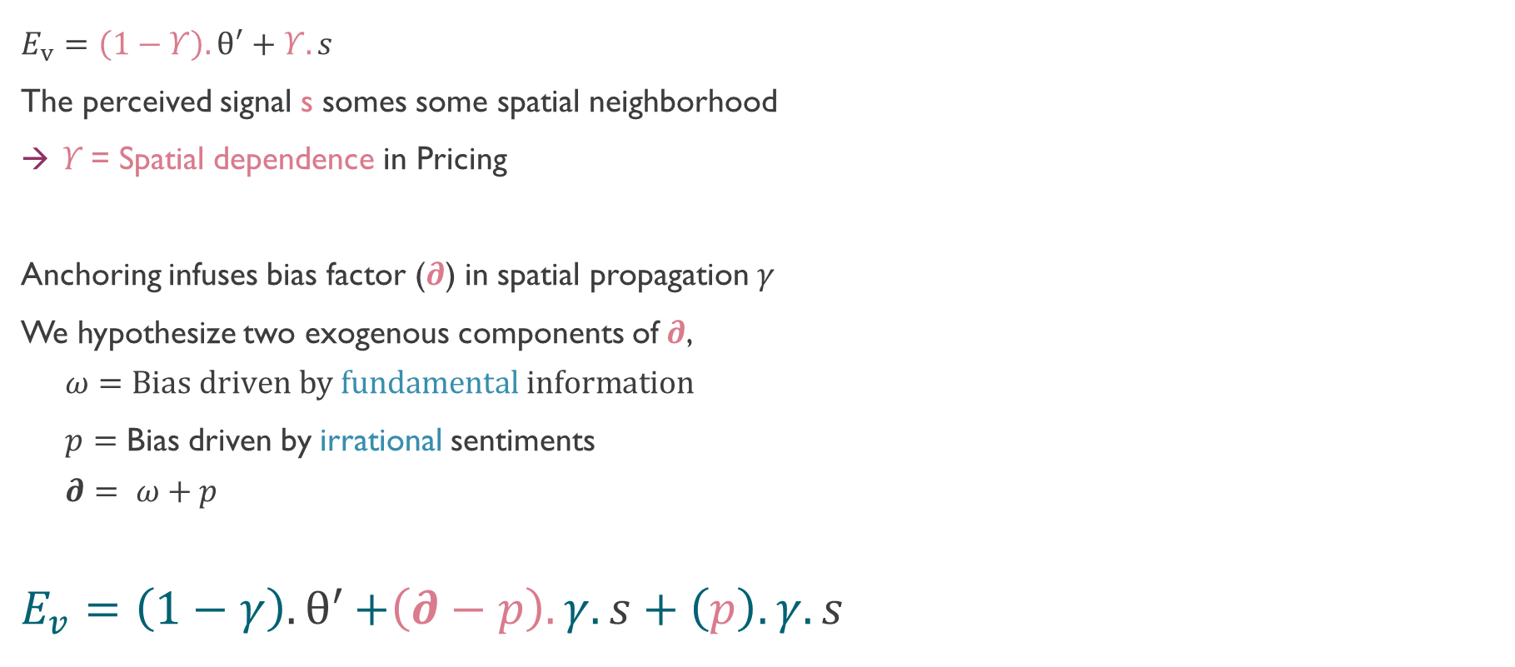
Spatial Autoregression: Rational & Anchored
$E_{v}=\left(1−Υ\right).θ^{′}+Υ.s$
The perceived signal s somes some spatial neighborhood
$Υ$= Spatial dependence in Pricing
Anchoring infuses bias factor ($∂$) in spatial propagation $γ$
We hypothesize two exogenous components of$∂$,
  $$ω=Bias driven by fundamental information$$
  $p=$ Bias driven by irrational sentiments
  $$∂= ω+p$$
$$E_{v}=\left(1−γ\right){.θ}^{′}+\left(∂−p\right).γ.s+\left(p\right).γ.s$$

Slide 16
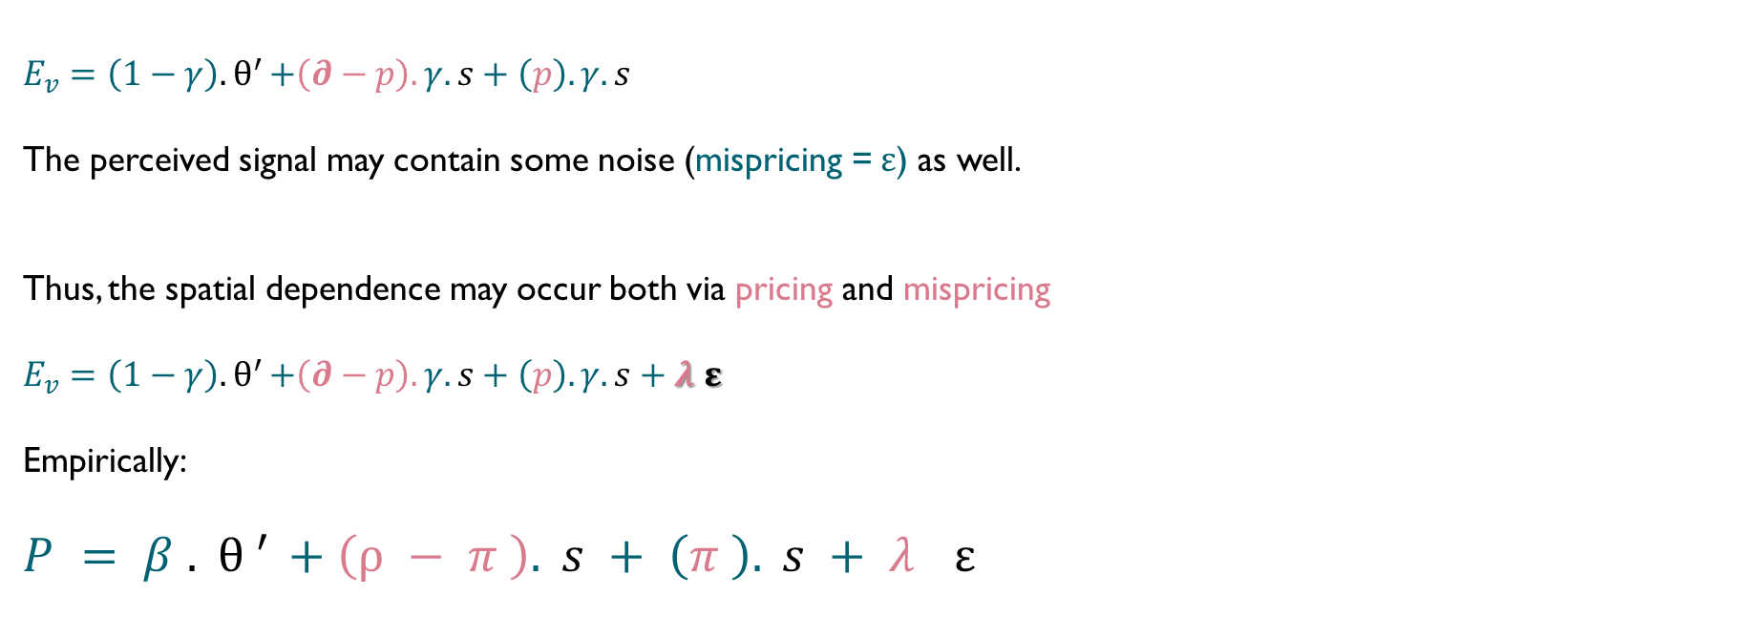
Spatial Propagation of Error
$$E_{v}=\left(1−γ\right){.θ}^{′}+\left(∂−p\right).γ.s+\left(p\right).γ.s$$
The perceived signal may contain some noise (mispricing =$ε$) as well.
Thus, the spatial dependence may occur both via pricing and mispricing
$E_{v}=\left(1−γ\right){.θ}^{′}+\left(∂−p\right).γ.s+\left(p\right).γ.s+λ$ $ε$
Empirically:
$P=β{.θ}^{′}+\left(ρ−π\right).s+\left(π\right).s+λ$ $ε$
Traditional hedonic models
Spatial autoregression
Spatial error

Slide 17
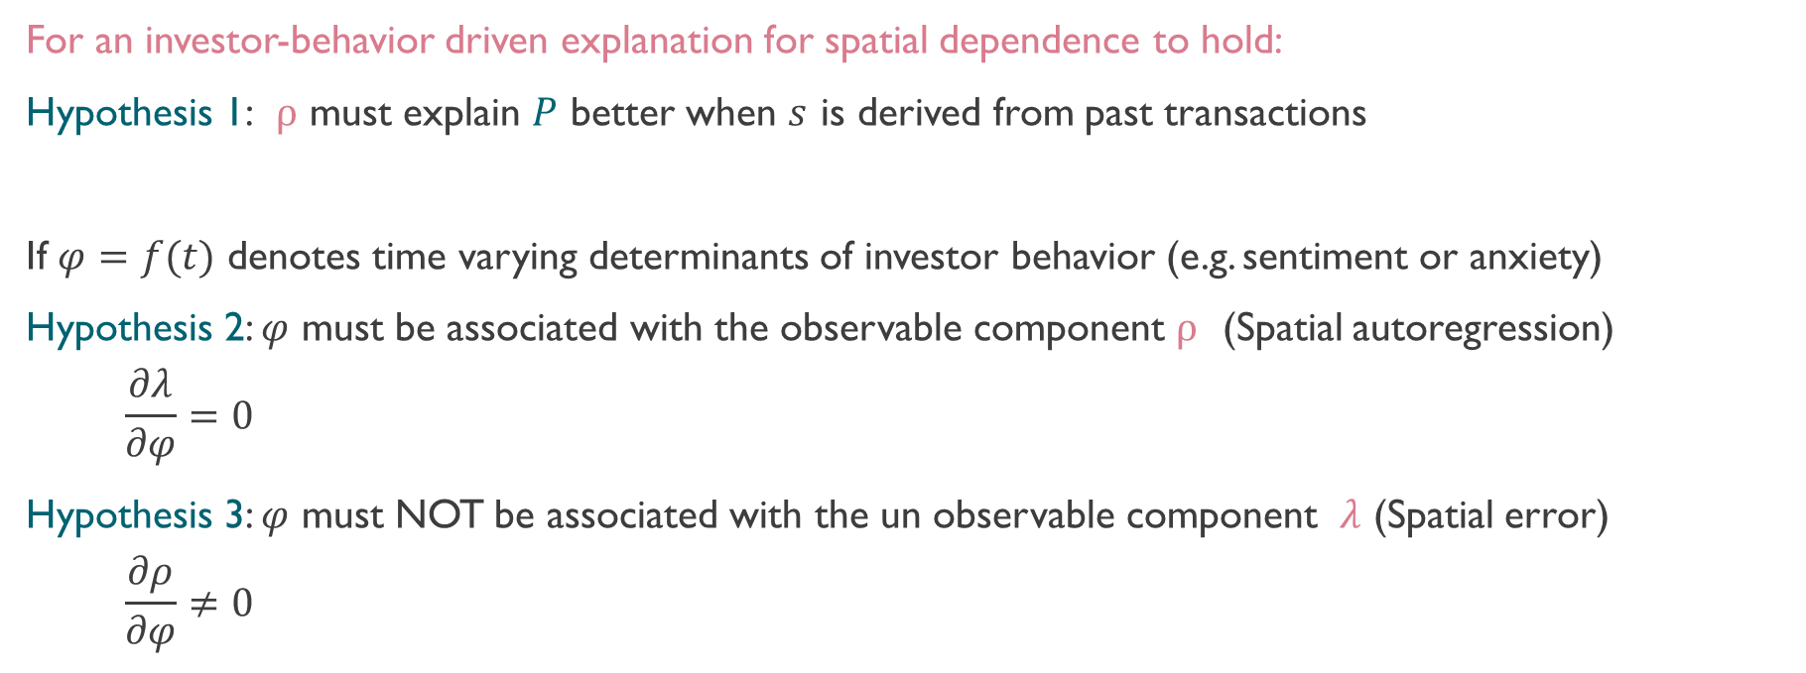
Hypotheses
Observable
Not Observable
$P=β{.θ}^{′}+\left(ρ−π\right).s+\left(π\right).s+λ$ $ε$
For an investor-behavior driven explanation for spatial dependence to hold:
Hypothesis 1:$ρ$must explain $P$better when $s$is derived from past transactions
If $φ=f(t)$ denotes time varying determinants of investor behavior (e.g. sentiment or anxiety)
Hypothesis 2: $φ$ must be associated with the observable component $ρ$ (Spatial autoregression)
  $$\frac{∂λ}{∂φ}=0$$
  Hypothesis 3: $φ$ must NOT be associated with the un observable component$λ$(Spatial error)
  $$\frac{∂ρ}{∂φ}≠0$$

Slide 18
Data

Slide 19
Data Sources
5,845 hotel transactions (2001-2016) in the US (CoStar)
Hotel attributes (STR)
Macroeconomic data on debt & equity (Federal Reserve, St. Louis)
Data on commercial loans (NCREIF)
Commercial property Price Index (Moody’s)
Investor sentiments (RERC)
Notes:
Why hotels?: unlike in other property types where relatively limited pricing attributes are available (e.g. size, and class), this sample provides stronger controls for asset and location attributes which helps in addressing the omitted variable bias (OVB) to a greater extent. The OVB has been a well-understood challenge with traditional hedonic pricing models (Corrado & Fingleton, 2012; Das et al., 2017; LeSage & Pace, 2009).

Slide 20
Data Summary | Cross Section
 | Mean | Min | Max | Stdev
SALEPRICE | 13,606,437 | 700,000 | 808,753,517 | 41,226,479
ROOMS | 126.34 | 10 | 2955 | 139.12
FLOORS | 4.41 | 1 | 60 | 4.68
SALEAGE | 27.59 | 0 | 218 | 21.12
LAND (Acres) | 5.57 | 0 | 2517 | 51.04
SIZES (sf) | 85,353.9 | 1 | 4,292,500 | 143,410
OPERATION
Chain Management | 0.07 | 0 | 1
Franchise | 0.66 | 0 | 1
Independent | 0.27 | 0 | 1
CLASS
Economy Class | 0.34 | 0 | 1
Luxury Class | 0.03 | 0 | 1
Midscale Class | 0.18 | 0 | 1
Upper Midscale Class | 0.21 | 0 | 1
Upper Upscale Class | 0.09 | 0 | 1
Upscale Class | 0.15 | 0 | 1
Only salient variables are presented in this table

Slide 21
Data Summary | Time Series (Quarterly)
 | Mean | Min | Max | Stdev
HRERC (Hotel Investor Sentiments) | 5.210 | 2.100 | 7.100 | 1.367
CPPI (Commercial Property Price Index) | 0.406 | -3.661 | 1.737 | 1.153
TERM (Spread) | 2.091 | -0.433 | 3.610 | 1.092
DEFAULT (Spread) | 4.817 | 1.179 | 8.535 | 1.625
INT.RATE (Hotel loans) | 0.057 | 0.020 | 0.080 | 0.011
LTV (Hotel loans) | 0.543 | 0.384 | 0.837 | 0.087
S&P500 | 0.338 | -7.882 | 4.907 | 2.839
VIX.S&P500 | 20.501 | 11.024 | 58.857 | 8.487
T3MON (Risk Free Rate) | 1.468 | 0.015 | 5.117 | 1.721
T10YR (Yield on 10-Year Treasury) | 3.559 | 1.643 | 5.272 | 1.071
IRR.SENT (Unexplained Sentiments) | 0.000 | -1.633 | 1.785 | 0.741
ANXIETY (Principal Component of relevant fundamentals) | 0.000 | -3.562 | 5.274 | 1.705

Slide 22
Methodology

Slide 23
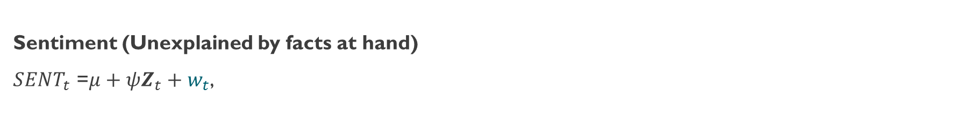
Step-1: Irrational Sentiments & Rational Anxiety
Sentiment (Unexplained by facts at hand)
${SENT}_{t}$ =$μ+ψZ_{t}+w_{t}$,
Anxiety (Explained by fundamentals)
Principal Component
Regression-Based Sentiment Partitioning
 | Estimate
(Intercept) | 7.322 | ***
CPPI | 0.646 | ***
TERM | -1.249 | ***
DEFAULT | 0.993 | **
INT.RATE | -18.539
LTV | -1.7117
S&P500 | -0.049
VIX.S&P500 | -0.124 | ***
R-squared: | 0.7058
Adj. R-squared: | 0.6662
F-statistic: | 17.82***
First Principal Component
 | Loadings
Return Measures
CPPI | -0.656
S&P500 | -0.255
Risk Measures
VIX.S&P500 | 0.801
DEFAULT | 0.955
TERM | 0.796
Leverage Measures
LTV | 0.169
INT.RATE | -0.383
Notes:
The first principal component explains 41% of variance

Slide 24
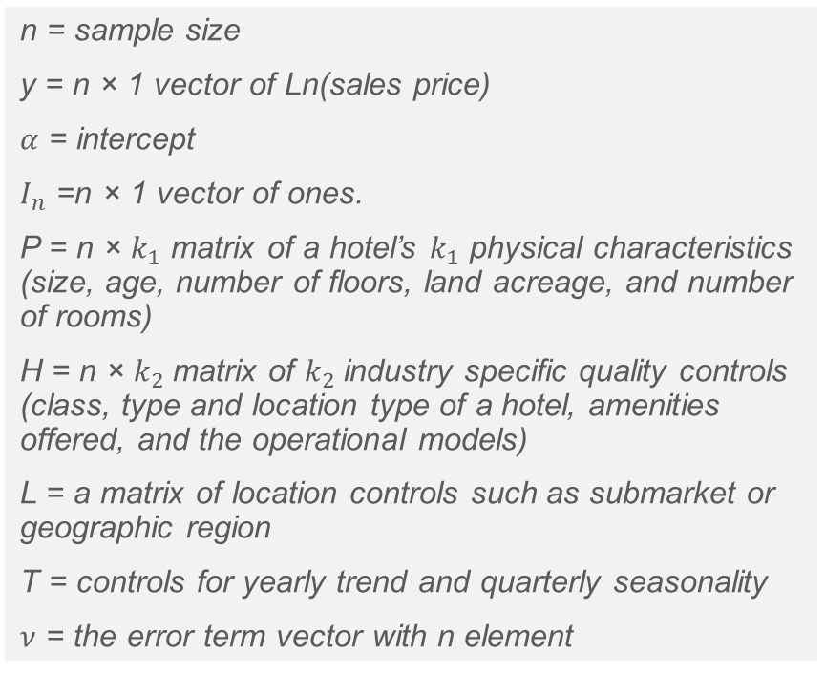
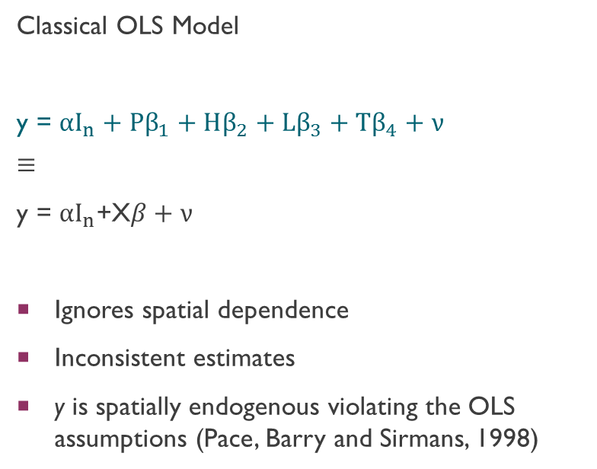
Step-2: Hedonic Model
Classical OLS Model
y = $αI_{n}+{Pβ}_{1}+Hβ_{2}+Lβ_{3}+Tβ_{4}+ν$
$$≡$$
$\text{y}\text{ = }αI_{n}$+X$β+ν$
Ignores spatial dependence
Inconsistent estimates
y is spatially endogenous violating the OLS assumptions (Pace, Barry and Sirmans, 1998)
n = sample size
y = n × 1 vector of Ln(sales price)
$α$ = intercept
$I_{n}$ =n × 1 vector of ones.
P = n × $k_{1}$ matrix of a hotel’s $k_{1}$ physical characteristics (size, age, number of floors, land acreage, and number of rooms)
H = n × $k_{2}$matrix of $k_{2}$industry specific quality controls (class, type and location type of a hotel, amenities offered, and the operational models)
L = a matrix of location controls such as submarket or geographic region
T = controls for yearly trend and quarterly seasonality
$ν$ = the error term vector with n element

Slide 25
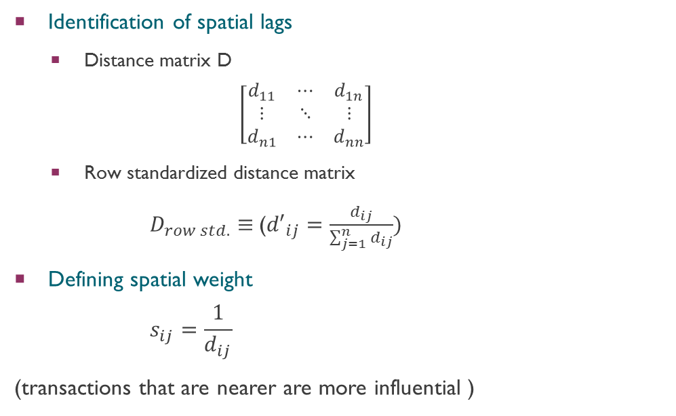
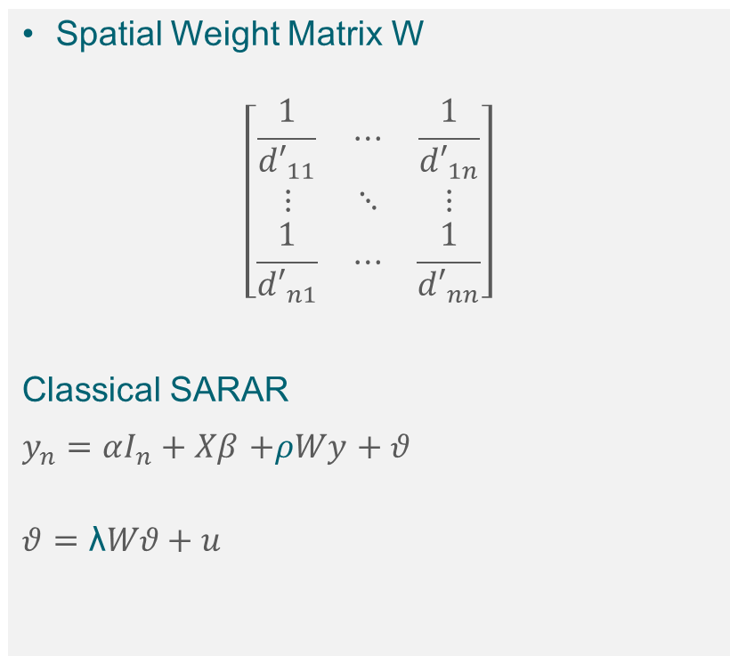
Spatial Hedonic Models
Spatial Weight Matrix W
$$\left[\begin{matrix}\frac{1}{{d′}_{11}} & ⋯ & \frac{1}{{d′}_{1n}} \\ ⋮ & ⋱ & ⋮ \\ \frac{1}{{d′}_{n1}} & ⋯ & \frac{1}{{d′}_{nn}}\end{matrix}\right]$$
Classical SARAR
$y_{n}=αI_{n}+Xβ$ $+ρWy$ $+ θ$
$$θ=\text{λ}Wθ+u$$
Identification of spatial lags
  Distance matrix D
  $$\left[\begin{matrix}d_{11} & ⋯ & d_{1n} \\ ⋮ & ⋱ & ⋮ \\ d_{n1} & ⋯ & d_{nn}\end{matrix}\right]$$
  Row standardized distance matrix
    $D_{row std.}≡$(${d′}_{ij}=\frac{d_{ij}}{\sum_{j=1}^{n}{d_{ij}}})$
Defining spatial weight
    $$s_{ij}=\frac{1}{d_{ij}}$$
(transactions that are nearer are more influential )
Notes:
Lambda reflects the spatial propagation of mispricing, whereas Rho directly reflects the spatial influence of pricing driven by rational or irrational factors.

Slide 26
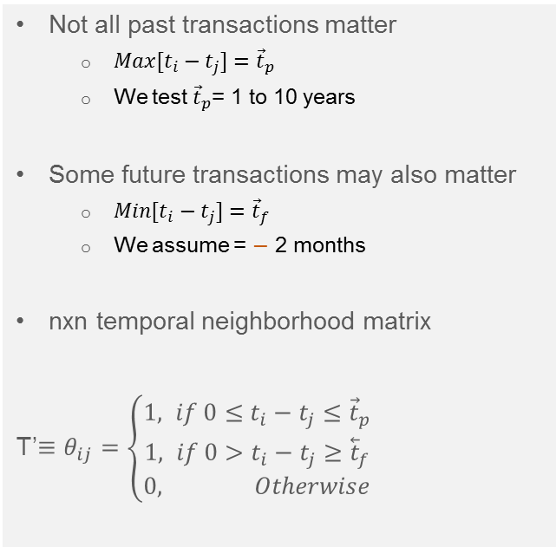
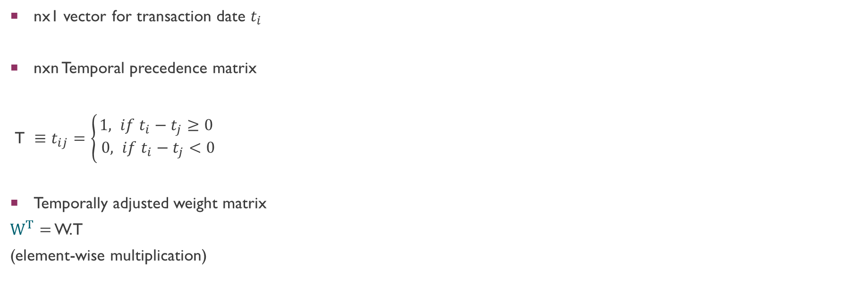
Temporally Adjusted Weight MAtrix
Not all past transactions matter
  ${Max[t}_{i}−t_{j}]={\vec{t}}_{p}$
  We test ${\vec{t}}_{p}$= 1 to 10 years
Some future transactions may also matter
  ${Min[t}_{i}−t_{j}]={\vec{t}}_{f}$
  We assume = $−$ 2 months
nxn temporal neighborhood matrix
T’$≡θ_{ij}=\left\{\begin{matrix}1, if {0≤t}_{i}−t_{j}≤{\vec{t}}_{p} \\ 1, if {0>t}_{i}−t_{j}≥{\overset{⃖}{t}}_{f} \\ 0, Otherwise\end{matrix}\right.$
nx1 vector for transaction date $t_{i}$
nxn Temporal precedence matrix
${\text{T} ≡t}_{ij}=\left\{\begin{matrix}1, if t_{i}−t_{j}≥0 \\ 0, if t_{i}−t_{j}<0\end{matrix}\right.$
Temporally adjusted weight matrix
$W^{T}$ $=$ W.T
(element-wise multiplication)

Slide 27
Results & Discussion

Slide 28
Baseline Hedonic Models: OLS & Spatial
 | OLS | SARAR-Temporal Precedence | SARAR-Temporal Neighborhood
(Intercept) | 11.5112*** | 10.2193*** | 10.2053***
Property Charecteristics | Included | Included | Included
Business Characteristics | Included | Included | Included
Location Characteristics | Included | Included | Included
Trend & Seasonality | Included | Included | Included
ρ |  | 0.1580*** | 0.1761***
λ |  | 0.8159*** | 0.6143***
R² | 0.7554
Adj. R² | 0.7471
Num. obs. | 5845 | 5845 | 5845
Log Likelihood |  | -5639.14 | -5645.12
LR test: statistic |  | 718.8*** | 706.8***
  Hypothesis 3:$ρ$must explain $P$better when $s$is derived from past transactions

Slide 29
Spatial Effects Varying with RATIONAL Anxiety
 | Fundamentals (Anxiety)
 | low | Low-mid | middle | Mid-hig | high
(Intercept) | 11.3423*** | 11.1202*** | 7.8684*** | 7.7759*** | 12.2687***
ρ | 0.0700* | 0.0529 | 0.2486*** | 0.2417*** | 0.2890***
λ | 0.4021*** | 0.5344*** | 0.2735*** | 0.5193*** | 0.1825*
Other hedonic variables | Included | Included | Included | Included | Included
Num. obs. | 1289 | 1088 | 1322 | 1000 | 1146
Log Likelihood | -1134.09 | -1172.75 | -1346.92 | -937.43 | -940.17
LR test: statistic | 70.3*** | 66.82*** | 80.8*** | 157.9*** | 83.4***
Hypothesis 1: $φ$ must be associated with the observable component $ρ$ (Spatial autoregression)
  Hypothesis 2: $φ$ must NOT be associated with the un-observable component$λ$(Spatial error)

Slide 30
Spatial Effects Varying with IRRATIONAL Sentiments
 | Irrational Sentiment in Hotel Investors
 | low | Low-mid | middle | Mid-high | high
(Intercept) | 8.2436*** | 10.0123*** | 12.8370*** | 11.0606*** | 11.1680***
ρ | 0.2233*** | 0.0977* | 0.1837*** | 0.0846* | 0.0792*
λ | 0.4069*** | 0.4408*** | 0.2596*** | 0.4519*** | 0.4518***
Other hedonic variables | Included | Included | Included | Included | Included
Num. obs. | 1265 | 1075 | 1319 | 1160 | 1026
Log Likelihood | -1104.15 | -1173.75 | -1296.92 | -1056.08 | -972.36
LR test: statistic | 117.0*** | 48.4*** | 66.2*** | 78.7*** | 80.8***
Hypothesis 1: $φ$ must be associated with the observable component $ρ$ (Spatial autoregression)
  Hypothesis 2: $φ$ must NOT be associated with the un-observable component$λ$(Spatial error)

Slide 31
cONCLUSIONS
Spatial propagation of pricing is the highest when the markets are in turmoil (high anxiety)
Spatial propagation of pricing is the highest when the investors are irrationally pessimistic (low unexplained sentiments)
Spatial propagation of (unobservable) mis-pricing does not seem to be a function of anxiety or sentiments

Slide 32
Thank you
Questions?

